Slide 1

Teaching mathematics through games at primary schools (grades 1-3)
Tomáš Brček

Slide 2
Contents
Introduction
Problem statement
Related work
Methodology
Analysis
Results and discussion
Conclusion

Slide 3
Table
ID | Country | Number of users (in millions)
1 | India | 329,65 | 28,98
2 | United States | 179,65 | 15,79
3 | Indonesia | 129,85 | 11,41
4 | Brazil | 116,00 | 10,20
5 | Mexico | 89,70 | 7,89
6 | Philippines | 82,85 | 7,28
7 | Vietnam | 70,40 | 6,19
8 | Thailand | 50,05 | 4,40
9 | Egypt | 44,70 | 3,93
10 | Bangladesh | 44,70 | 3,93
 |  | 1137,55

Slide 4
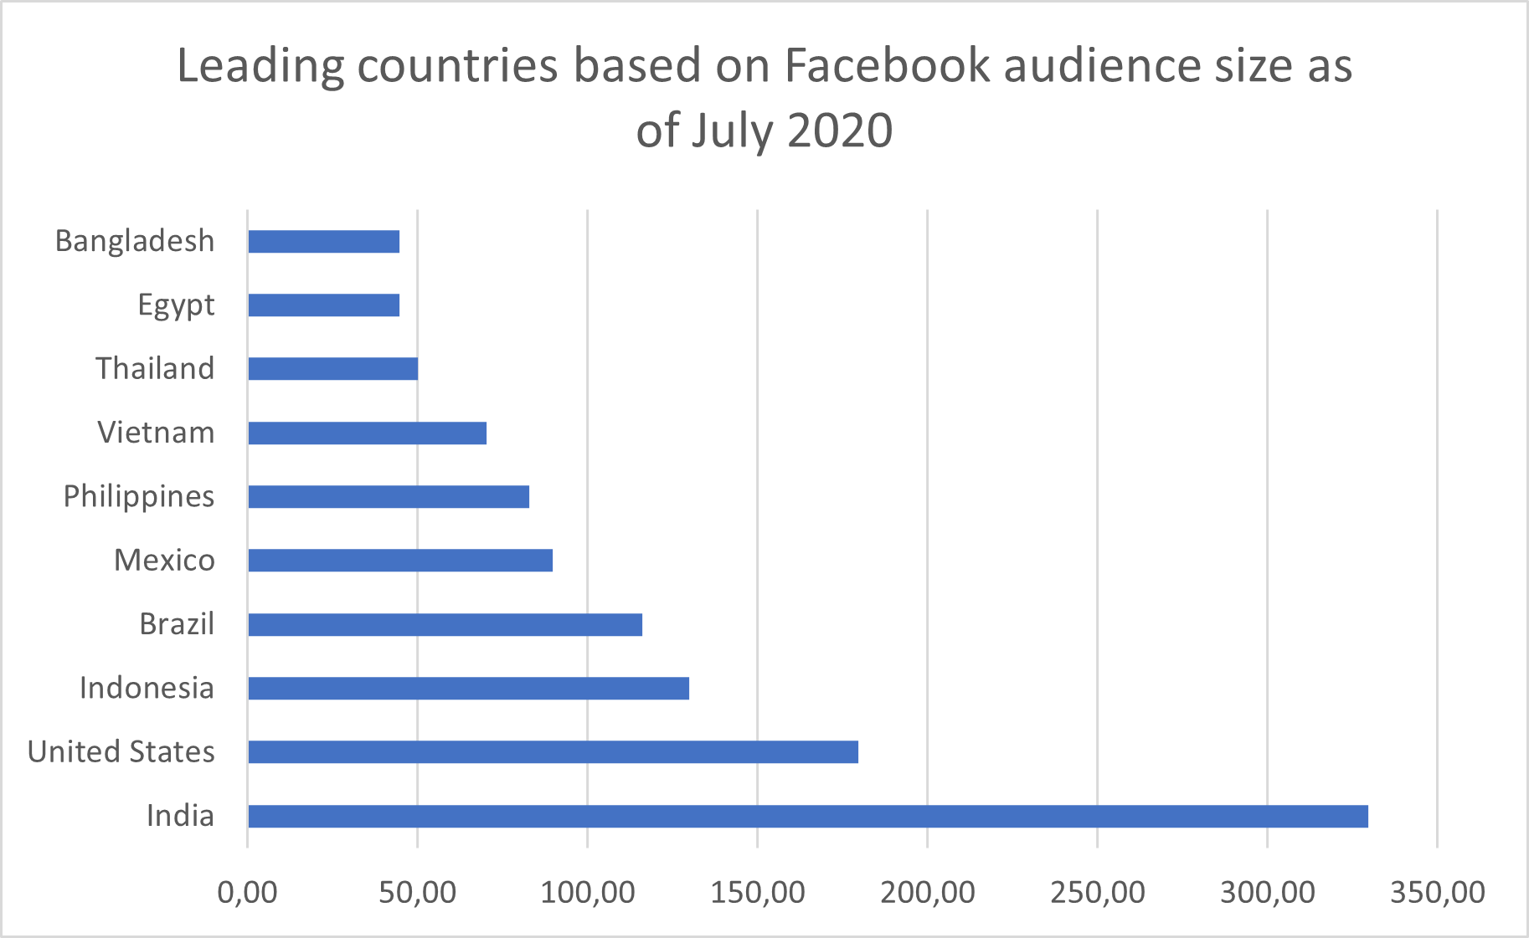
Graph

